Slide 1
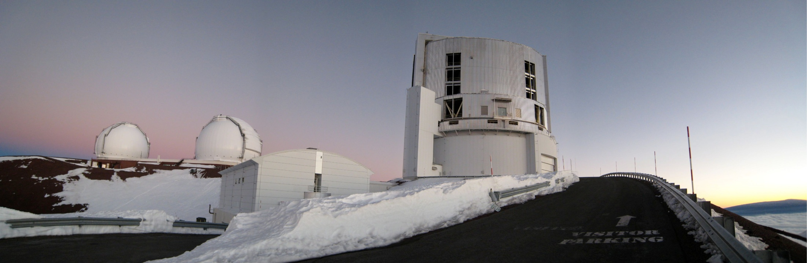
Galaxy Evolution and Environment (Malaysia, 03/04/2009)
Inside-out propagation of star forming activity in clusters
Build-up of the red sequence of galaxies through cosmic time and across environment
Taddy Kodama (NAOJ), Yusei Koyama (Univ. of Tokyo), Masao Hayashi (Univ. of Tokyo) Masayuki Tanaka (ESO), and the PISCES/HzRG team

Slide 2
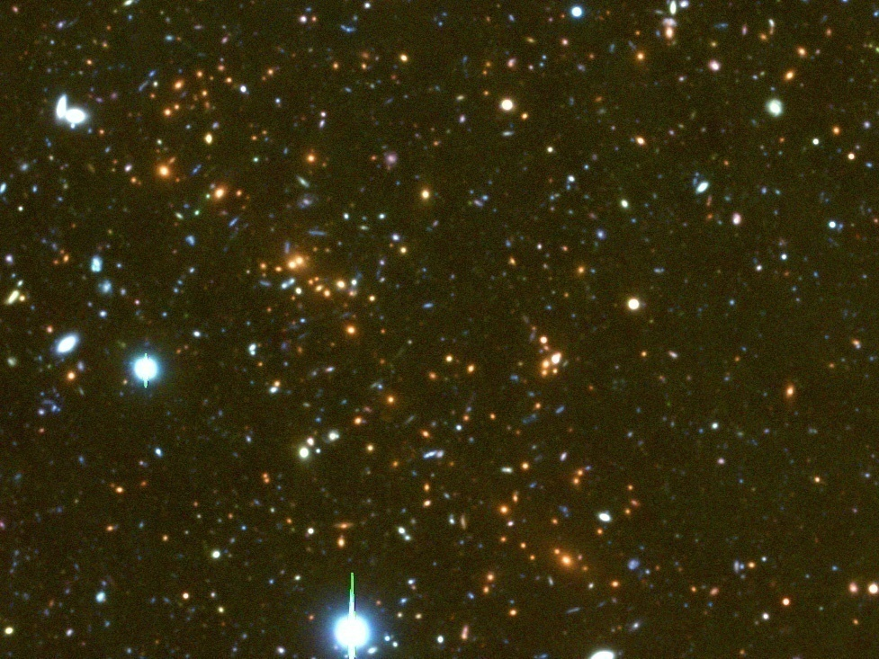
Outline
Large scale structures in and around clusters at all redshifts (0.4<z<3)
Starbursts and truncation in groups/outskirts at z<1 (z~0.8)
(Koyama+ 08;09 in prep.; see Koyama’s poster)
High SF activity in the cluster core at z~1.5
(Hayashi+09, in prep)
Disappearance of the red sequence at z>2

Slide 3
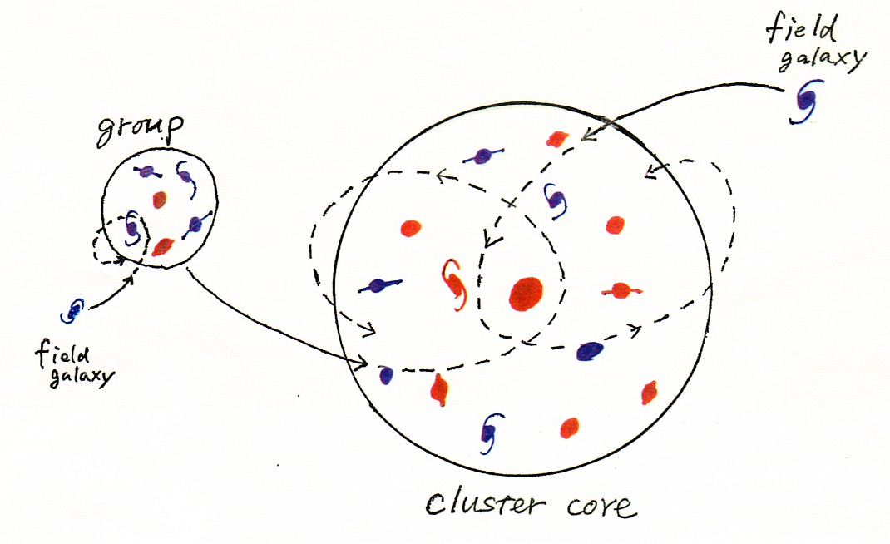

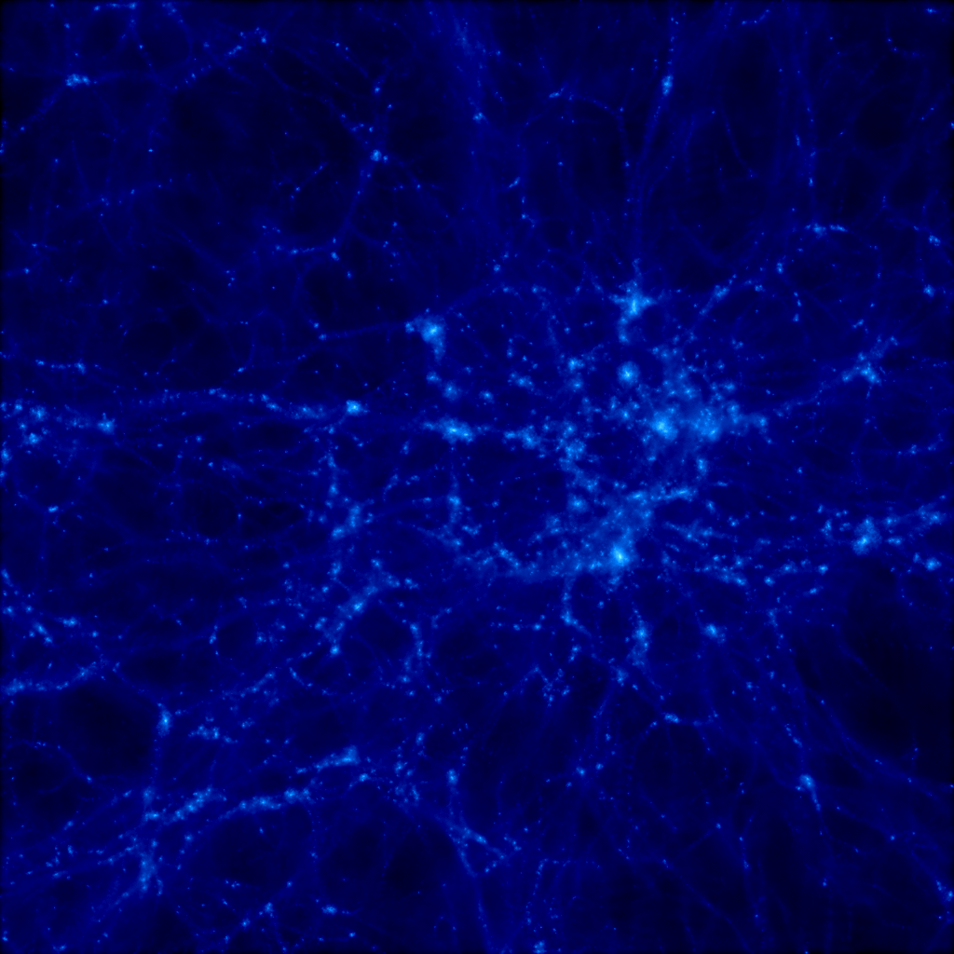
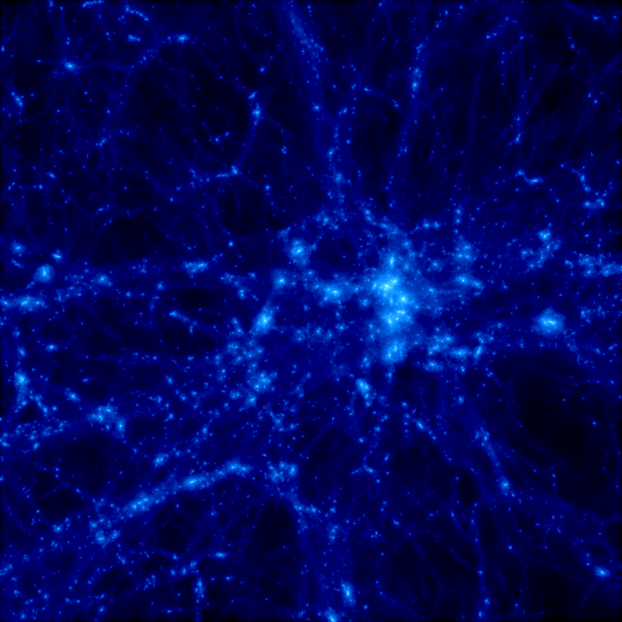
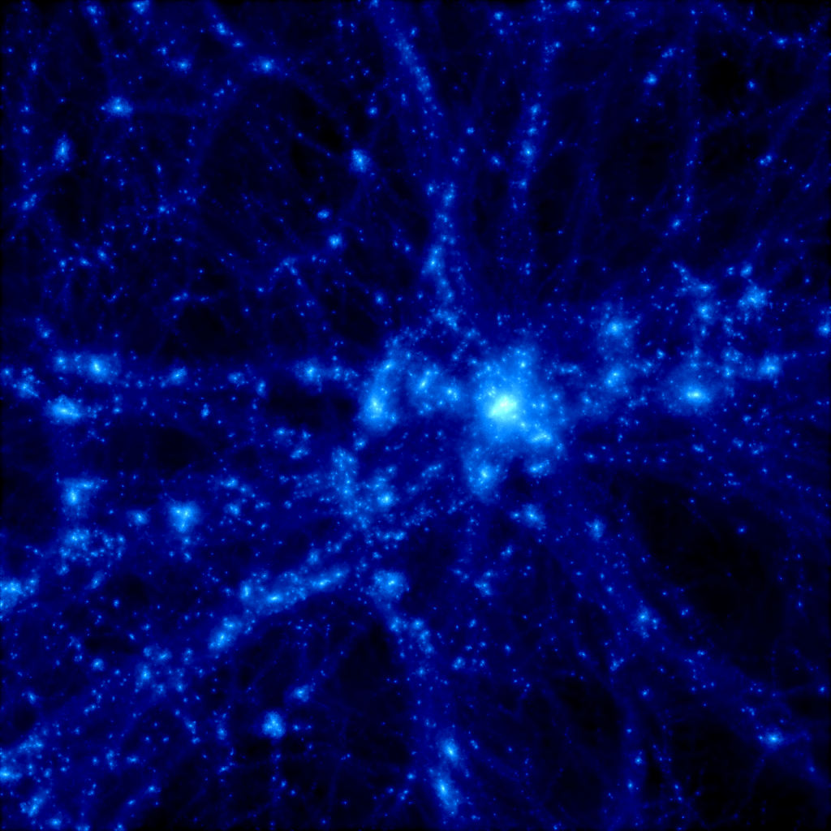
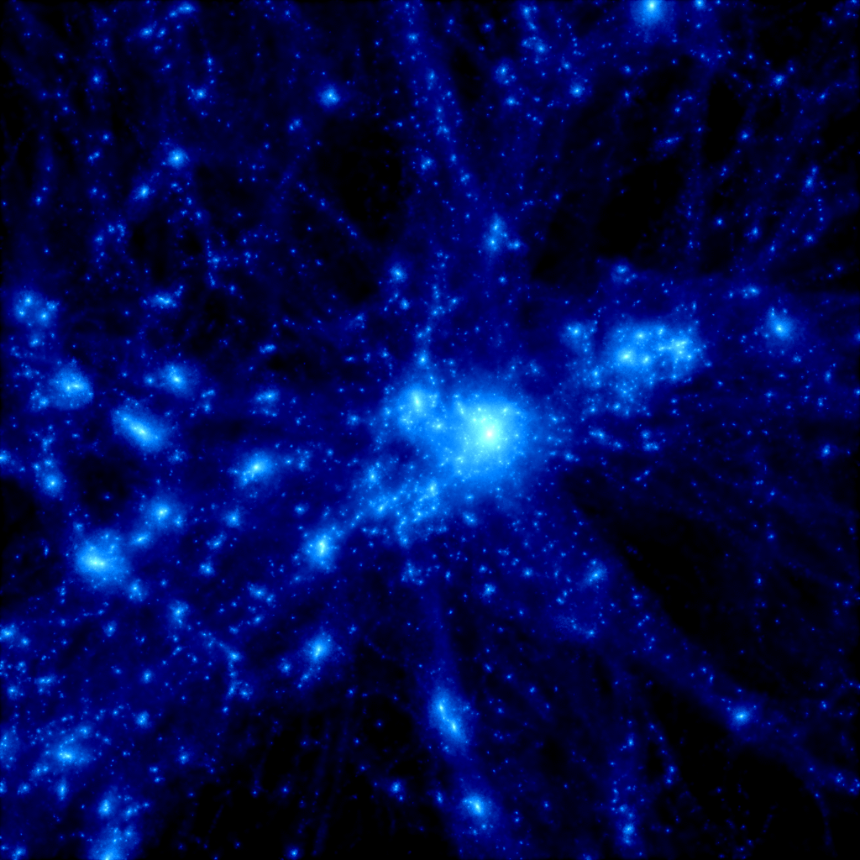
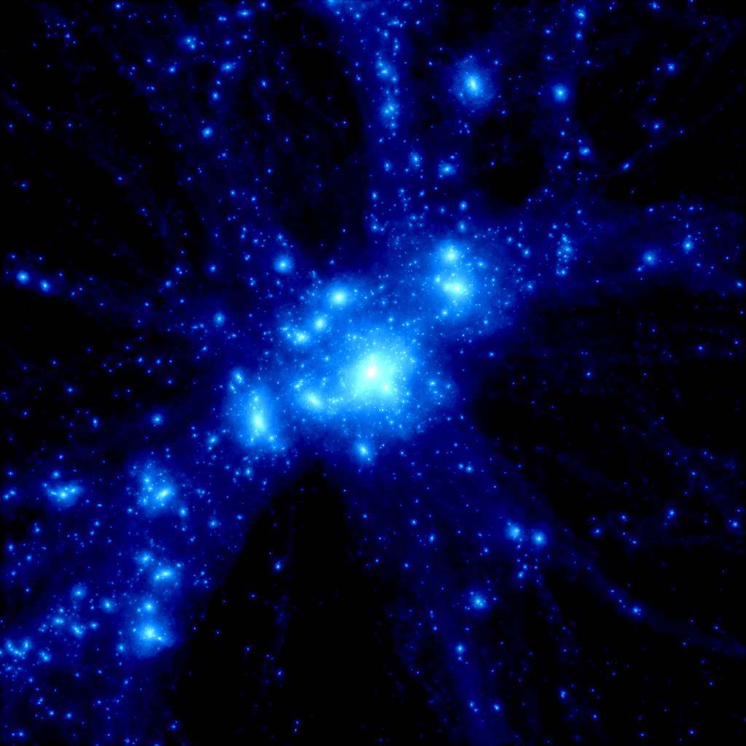
Origin of Environmental Dependence
N-body simulation of a massive cluster
z = 30
z = 5
(Yahagi+05)
z = 3
z = 2
MOIRCS (NIR)
4’×7’
Nature? (intrinsic)
Need to go higher redshifts as it becomes more important at high-z.
Nurture? (external)
Need to go outer infall regions to see directly what’s happening there.
Nature? (intrinsic)
earlier galaxy formation and more massive haloes in dense environments
Nurture? (external)
galaxy-galaxy interaction/mergers, gas-stripping
Suprime-Cam (Opt)
34’×27’
z = 1
z = 0
M=6×10¹⁴ M◎ 20×20Mpc² (co-moving)

Slide 4

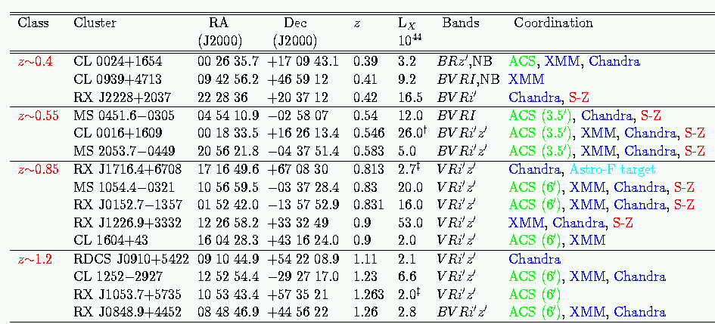
Panoramic Imaging and Spectroscopy of Cluster Evolution with Subaru
~10 X-ray detected clusters at 0.4 < z < 1.45
( )
( )
,NB
( )
( )
( )
ACS(3.5’)
( )
1.14
XMM
z~1.4
(XMMU2235.3-2557) 22 35 20.6 -25 57 42.0 1.393 3.0 VRi’z’
XMMJ2215.9-1738 22 15 58.5 -17 38 02.5 1.45 4.4 VRi’z’,NB
XMM
XMM
Kodama et al. (2005)

Slide 5
High redshift(z) Radio Galaxies [HzRG] with Subaru, VLT, and Spitzer
7 confirmed proto-clusters at 2 < z < 5.2 associated to radio galaxies
Overdense regions in Lyman-α emitters by a factor of 3—5.
Name redshift NIR Spitzer Lya spectra others
PKS 1138-262 2.16 JHKs 3.6--8.0 16 NIR/Opt Ha, VLA, Chandra, SCUBA
4C 23.56 2.48 JHKs 3.6--8.0 NIR Ha
USS 1558-003 2.53 JHKs 3.6--8.0
USS 0943-242 2.92 JHKs 3.6--24.0 29 Opt
MRC 0316-257 3.13 JHKs 3.6--8.0 32 NIR
TNJ 1338-1942 4.11 JHKs 3.6--8.0 37 Suprime-Cam, VLA, MAMBO
TNJ 0924-2201 5.19 JHKs 3.6--24.0 6 Suprime-Cam/ACS (LBGs)
primarily using MOIRCS/Subaru and Hawk-I/VLT
Kodama et al. (2007), De Breuck et al. (Spitzer HzRGs)

Slide 6
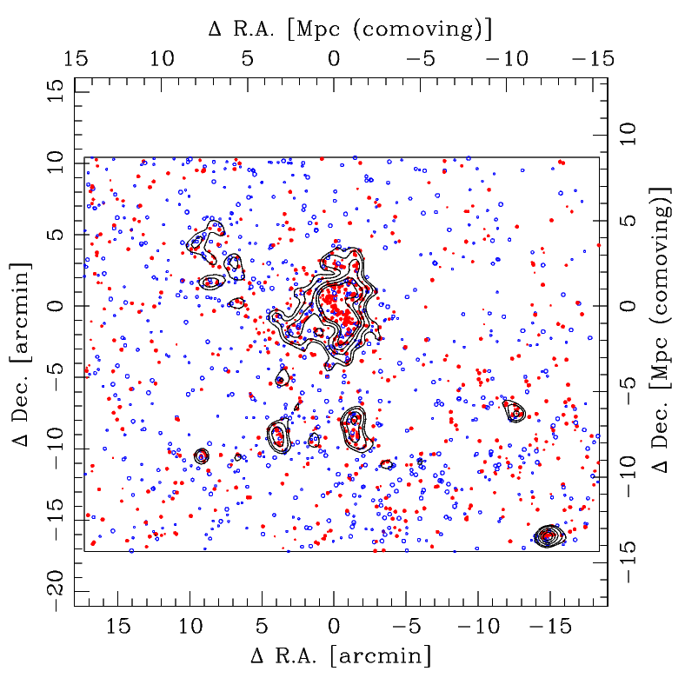
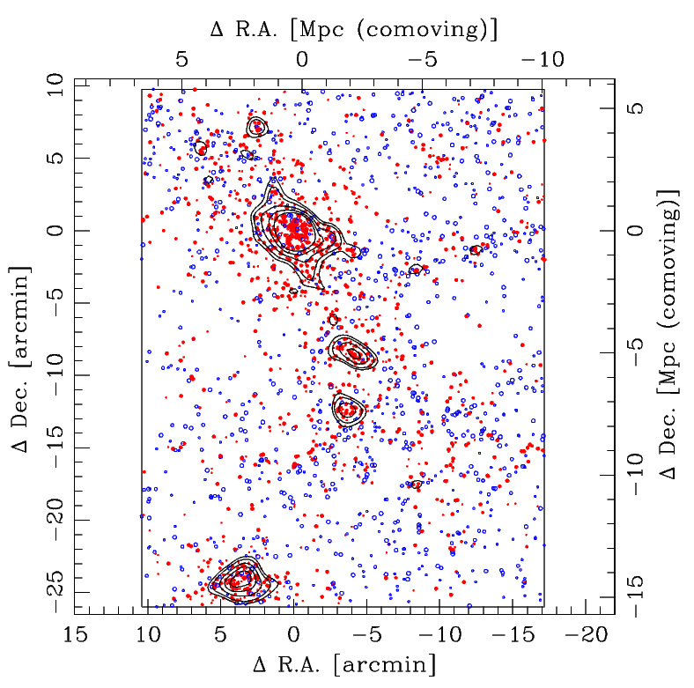
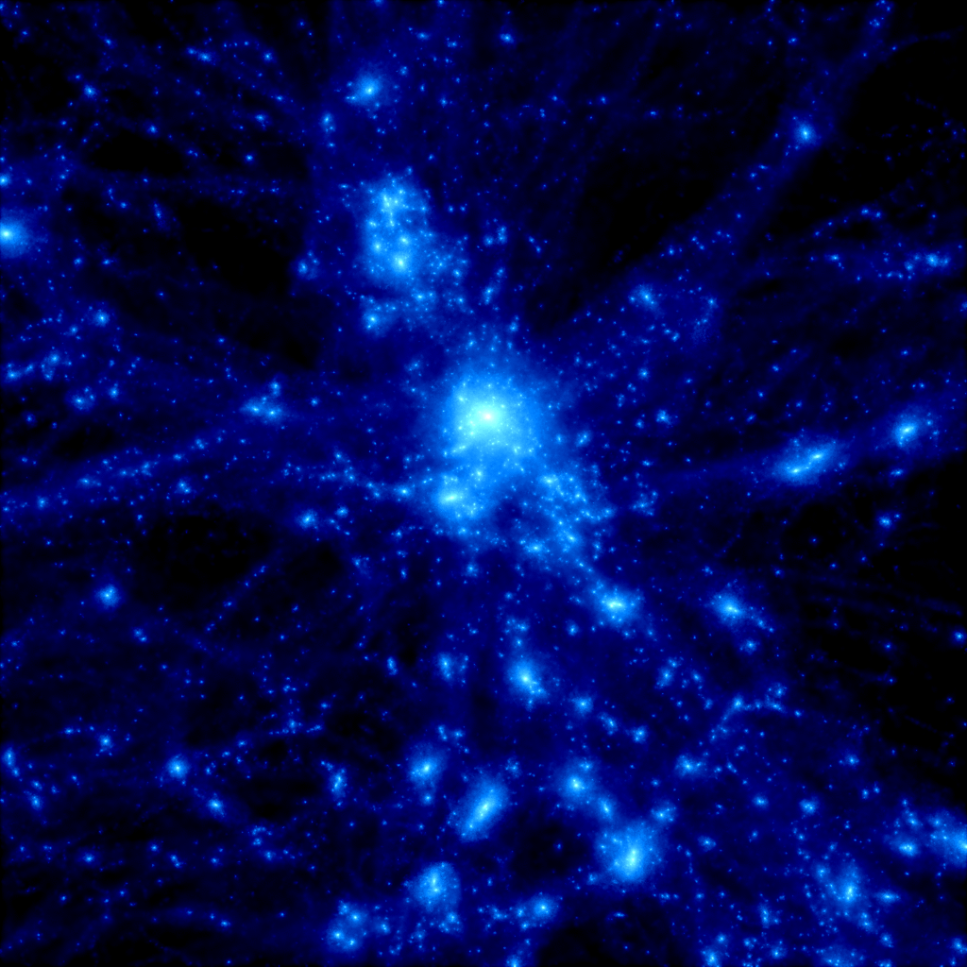
Panoramic Views of Cluster Assembly
Spatial distribution of phot-z members (Δz =－0.05~+0.03)
RXJ 0152.7-1357 (VRIz’)
CL 0016+16 (BVRi’z’)
z = 1
z=0.83 (7Gyr ago) z=0.55 (5.4Gyr ago)
simulation
Kodama, et al. (2005)

Slide 7
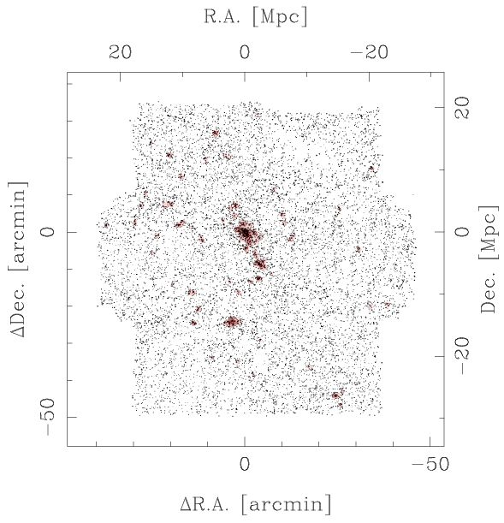
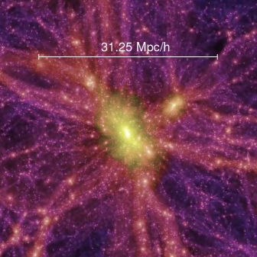
A Huge Cosmic Web at z=0.5 over 50 Mpc
(80’x80’ by 7 S-Cam ptgs.)
CL0016 cluster (z=0.55)
S-Cam
Millenium Simulation
(Springel et al. 2005)
Traced by red-sequence galaxies in V-I colours
(Tanaka, et al., in prep.)

Slide 8
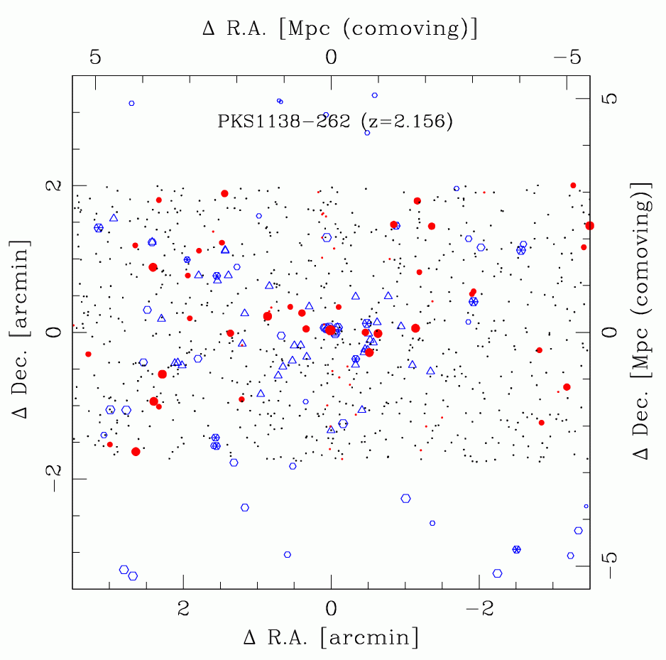
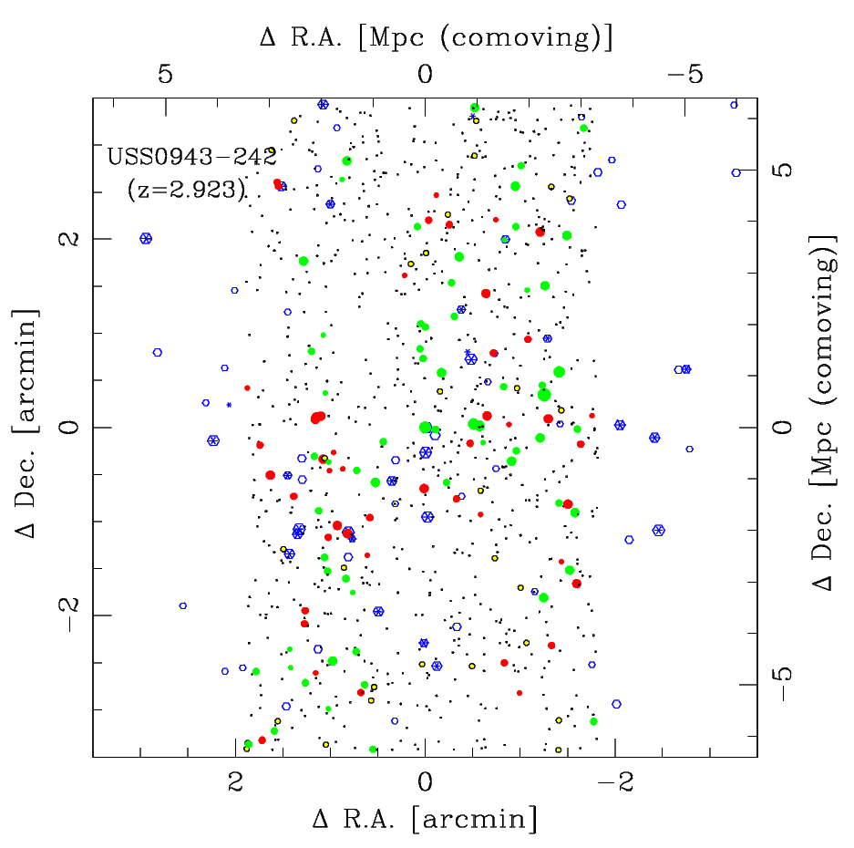
Structures in proto-clusters
Spatial distribution of NIR-selected member candidates and emitters
Kodama, et al. (2007)
● DRG
○Lyα △Hα
● DRG ● r-JHK ● b-JHK ○Lyα
PKS 1138-262
(z~2, 10.5Gyr ago)
USS 0943-242
(z~3, 11.5Gyr ago)
simulation
z = 2

Slide 9
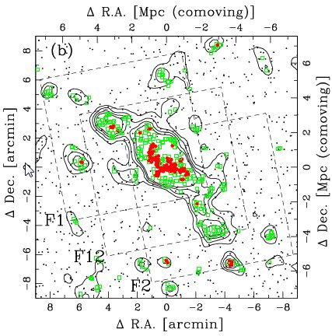
Sharp colour transition in groups/outskirts
銀河の色は中間的な環境で急激に変化する
RXJ1716 cluster (z=0.81)
med
high
low
（赤い銀河の割合）
high ～ cluster core
med ～ group / filament
low ～ field
Koyama, TK, et al. (2008)

Slide 10
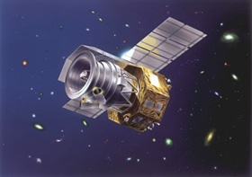
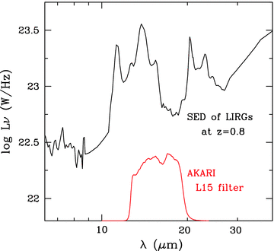
AKARI “Deep” and “Wide” MIR Imaging of a NEP Cluster RXJ1716 (z=0.81)
Koyama, TK, et al. (2008), see also a poster by KOYAMA
AKARI
IR satellite, D=69cm, 1.7<λ<180μm
AKARI
Spitzer
Subaru
Deep imaging (67μJy) at 15μm →
PAH (7.7μm) at z=0.81
Dusty star forming galaxies (LIRG/ULIRG) SFR > 20 Msun/yr (L_{IR} > 10¹¹ Lsun)

Slide 11
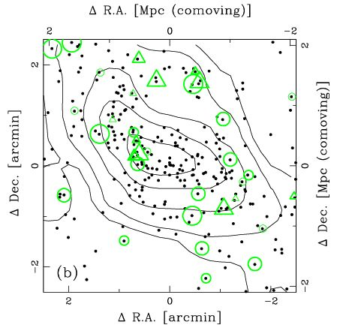
Spatial Distribution of the 15μm sources
A void of 15um sources at the center!
X-ray (Chandra) map
(Jeltema et al.)
○single /△blended 15μm sources
Koyama, TK, et al. (2008)

Slide 12
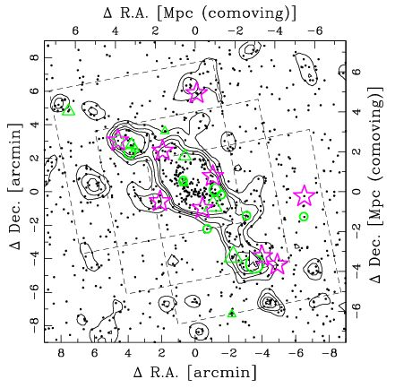
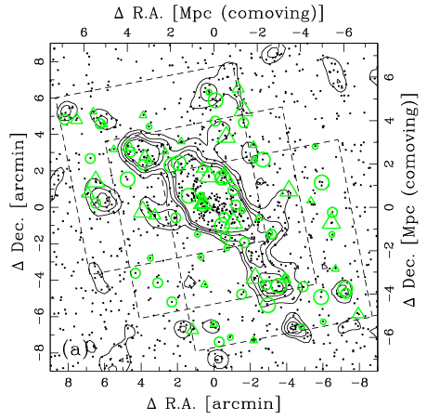
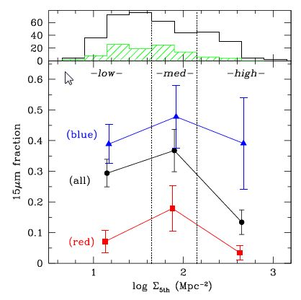
Spatial Distribution of the 15μm sources
f(15μm) > 67 μJy
Optically red 15μm sources are preferentially found in the medium density regions.
○△ red15μm sources (dusty)
high SSFR (starbursts)
Koyama, TK, et al. (2008), see also talk by Saintonge/Haines/Gallazzi…

Slide 13
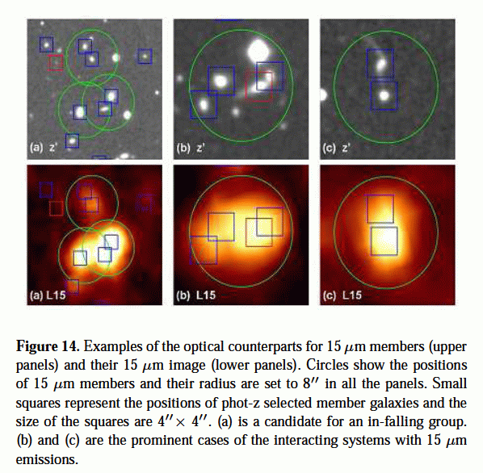
Interacting Galaxies in the 15μm sources
Subaru
(optical)
16” = 130kpc
AKARI
(NIR)
Koyama, TK, et al. (2008)

Slide 14
A narrow-band Hα imaging with MOIRCS/Subaru
RXJ1716 cluster (z=0.813)
J ～ 30min (23.1 mag, AB, 5σ) → continuum
NB119 ～ 100min (22.7 mag, AB, 5σ) → Hα emission
NB119
J
AKARI FOVs
Ha emission from z=0.81 galaxy
MOIRCS FOV
NB119
resp. func.
○：15μm sources
spec-z distribution
(Gioia+ 99)
Koyama, TK, et al. (2008), see also a poster by KOYAMA

Slide 15
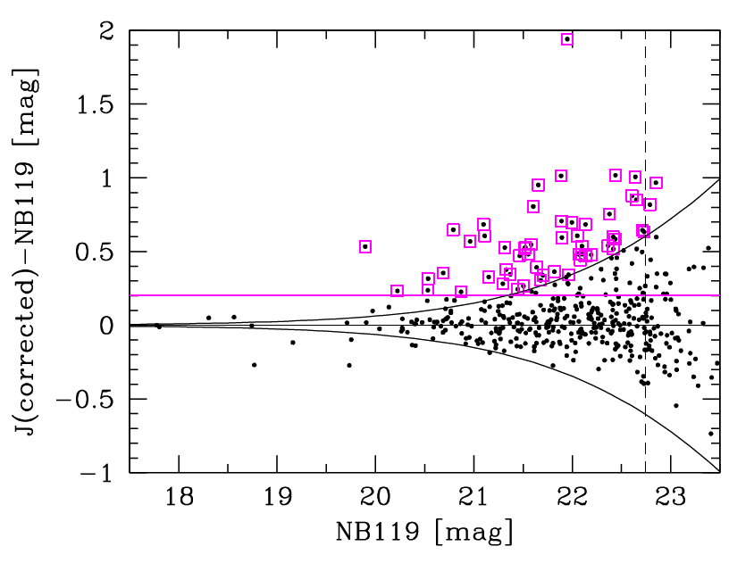
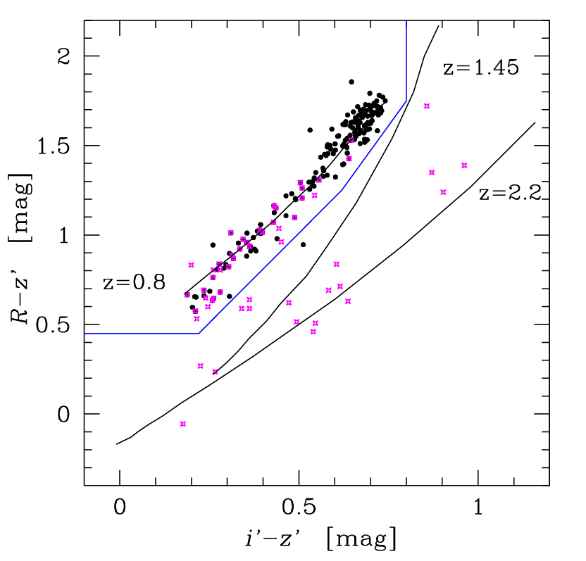
Selection of Hα Emitters associated
to the RXJ1716 cluster (z=0.81)
SFR (Hα) > 1.5 M◎/yr
Definition of emitters
3σ error in colours
[OIII]
[OII]
Hα
EW～20A
5σ
Hα emitters are defined as the NB119 emitters which are either
phot-z members (27) or those at the top-left corner in Ri’z’ diagram (10).

Slide 16
Spatial Distribution of Hα emitters
Hα emitters are avoiding the central region ( Rc < 230kpc ) and preferentially found in the surrounding regions.
None!
MOIRCS FoV
None !
:
Ha emitter with > 2 Msun/year
distance from the x-ray centre
Spatial distributions of Hα emitters and 15μm sources are similar (but direct overlaps are only 8).

Slide 17
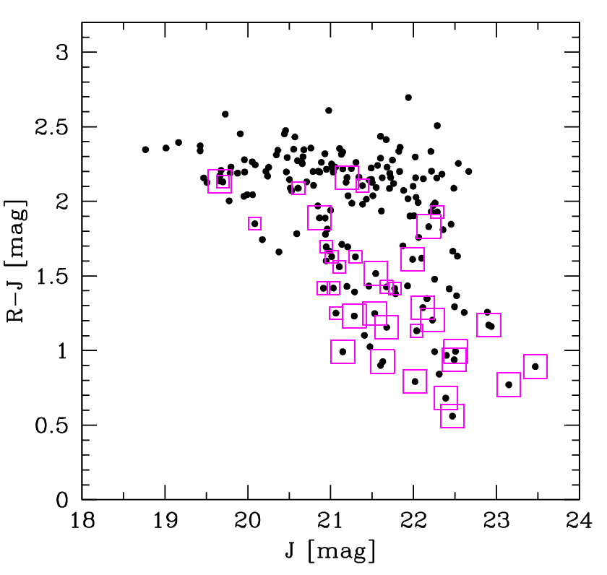
Hα emitters on the red sequence!
Most of them are located in the outer region ( Rc>500kpc ).
□ ： EW > 50 A
□ ： EW < 50 A
□ Hα emitters

Slide 18
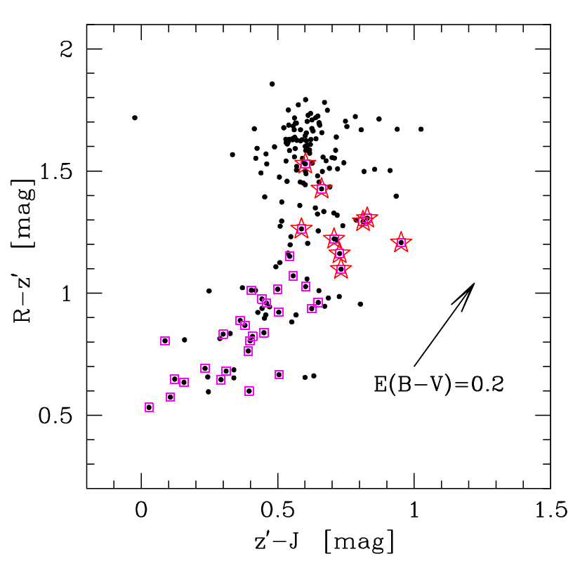
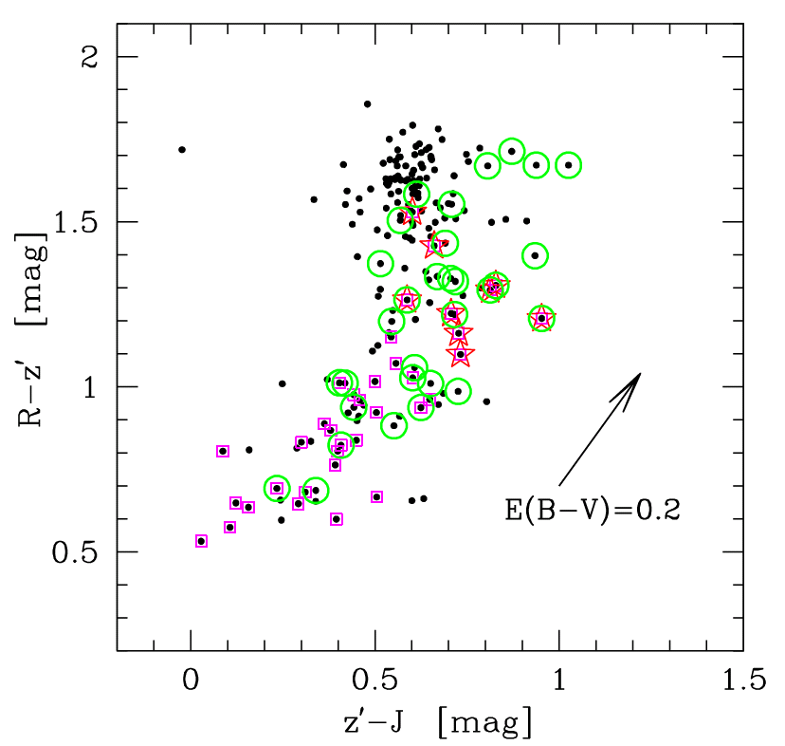
What are the red Hα emitters?
Koyama, TK, et al. (2009)
Strong dust extinction even for Hα? (or dusty AGN?)
R
z’
J
□ blue Hα
emitters
☆ red Hα emitters
○ 15μm sources
(Pozzetti+2000)
A similar method that are used to separate between passive/dusty EROs with IJK
that measures the sharpness of the 4000Å/Balmer break feature.
There may be a large amount of hidden star formation in IR
which is not seen even with Hα??

Slide 19
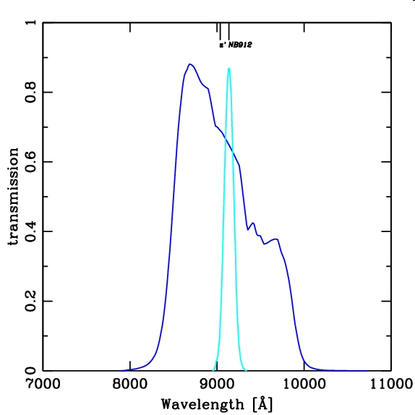
A narrow-band [OII] imaging with Suprime-Cam/Subaru (XCS2215@z=1.457)
Hayashi et al. (2009), in prep.
XMMXCS J2215.9-1738
z’
[OII] @ z=1.46
↓
NB912
NB912 filter
(λc=9139A, Δλ=134Α)
(Stanford+06 )
instruments | Suprime-Cam |  |  | MOIRCS
passbands | B | z’ | NB912 | J | Ks
dates | 2008. 07.30-31 |  |  | 2008. 06.30-07.01
pointings | 1 |  |  | 4
FoV | 32’ x 23’ |  |  | 6.1’ x 5.8’
3σ mags | 27.59 | 25.81 | 25.75 | 23.84-24.57 | 23.07-23.65
seeing | 1.09” |  |  | 1.09”

Slide 20
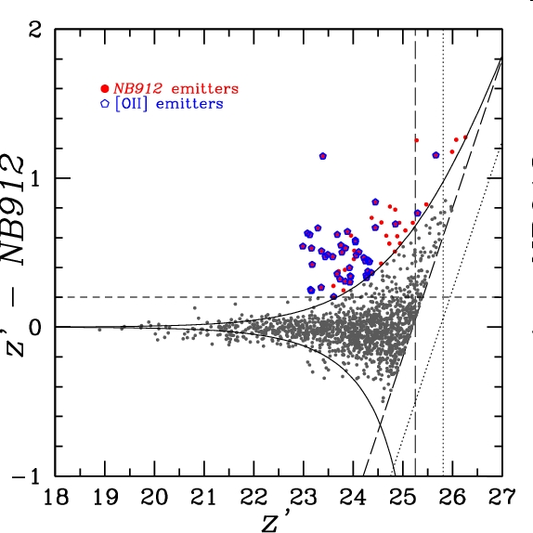
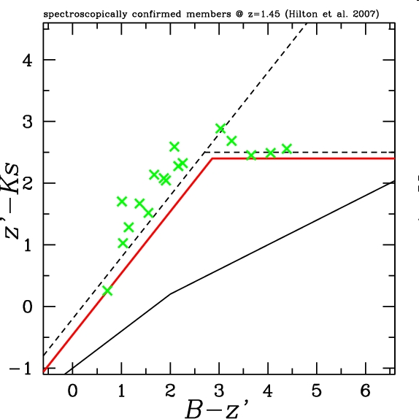
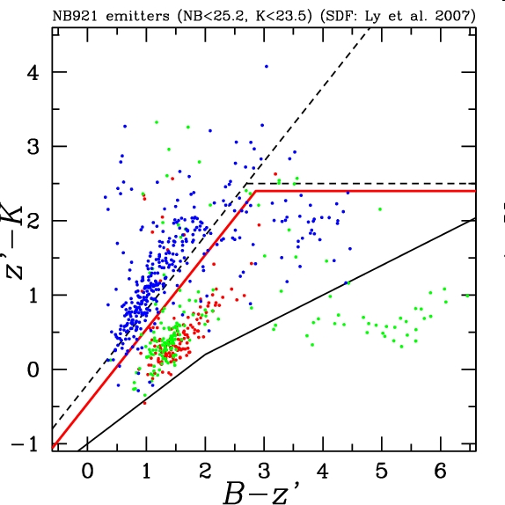
Selection of [OII] emitters associated to the
XCS2215 cluster (z=1.46)
5σ
3σ
NB912 emitters
Spectroscopically confirmed
members (Hilton et al. 2007)
[OII] emitters (44)
[OII] @ z=1.46
Hα @ z=0.4
3σ
[OIII] @ z=0.84
SFR ([OII]) > 2.6 M◎/yr
Hayashi et al. (2009), in prep.

Slide 21
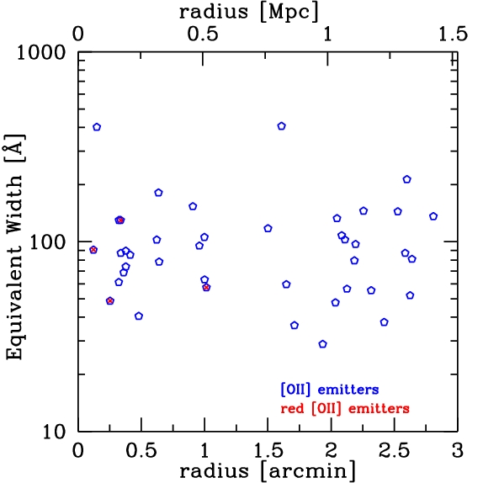
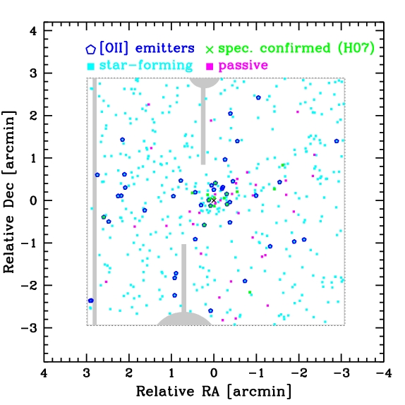
Spatial Distribution of the [OII] emitters
High star formation activity to the very center of the cluster!
(AGN contamination?)
Hayashi et al. (2009), in prep.

Slide 22
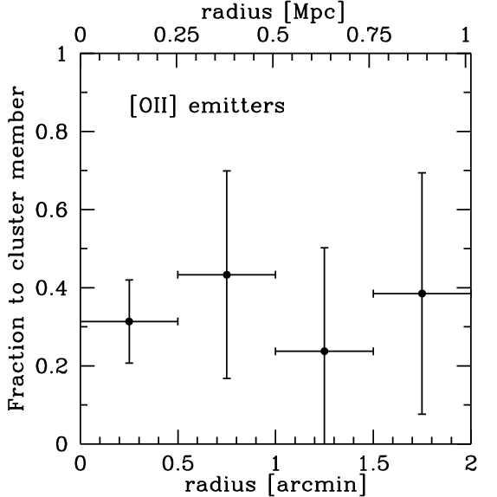
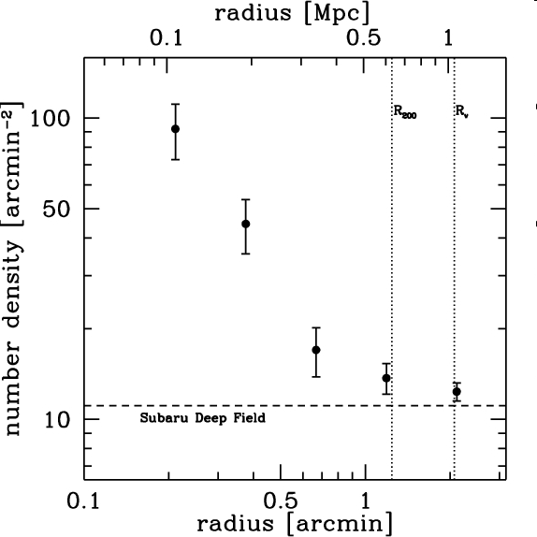
Spatial Distribution of the [OII] emitters
fraction
to field corrected phot-z members
High star formation activity to the very center of the cluster!
(AGN contamination?)
Hayashi et al. (2009), in prep.

Slide 23
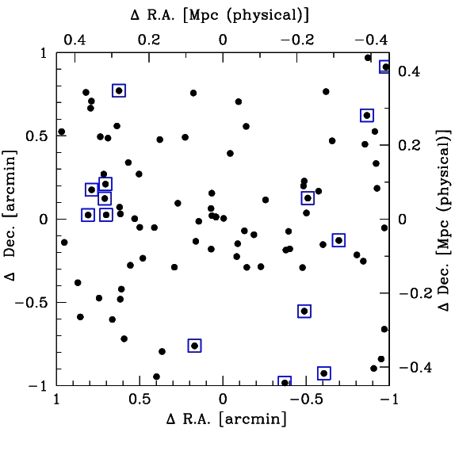
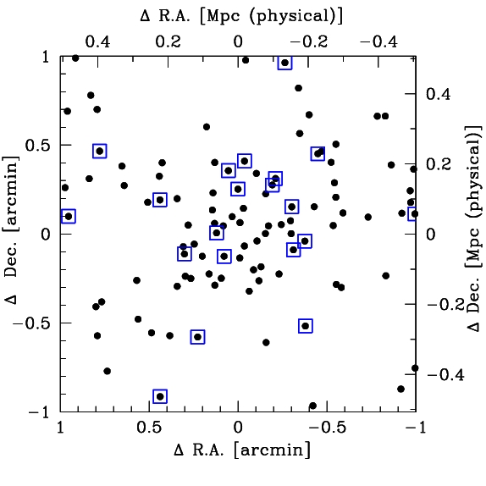
Star forming activity in the cluster cores
□
Hα emitters at z=0.81 (RXJ1716)
□
[OII] emitters at z=1.46 (XCS2215)
●
phot-z members
Koyama, TK, et al. (2009)
Hayashi, TK, et al. (2009)
Inside-out propagation of star forming activity in cluster cores !?

Slide 24
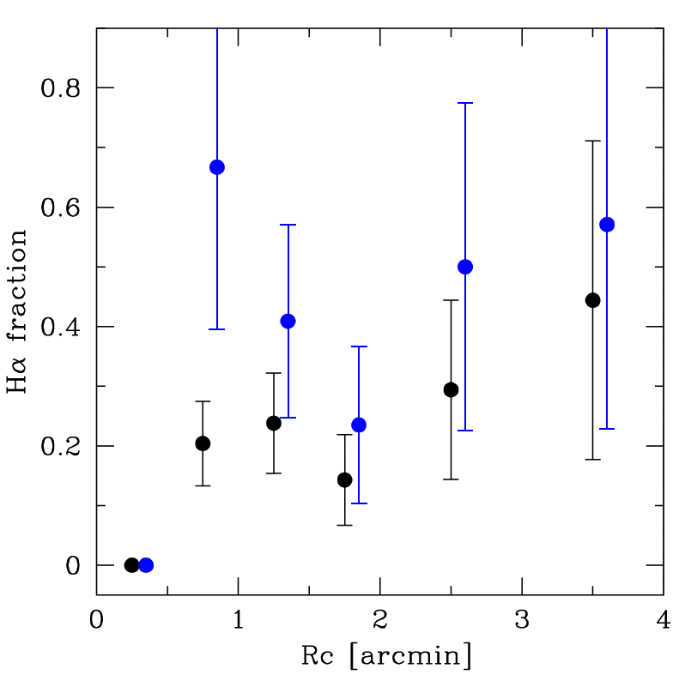
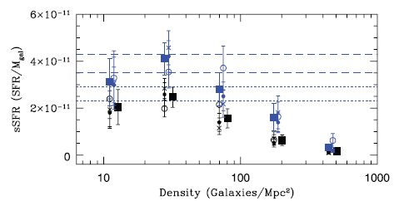
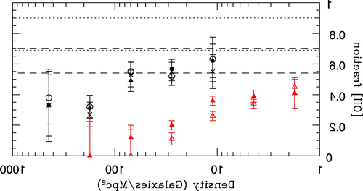
Can we eventually see a reversal of the SFR-Rc / SFR-density relations?
Hα @ z=0.4
Hα @ z=0.8
[OII] @ z=1.5
(Koyama+09)
(Hayashi+09)
(Kodama+04)
Radius [Mpc]
Radius [arcmin]
Radius [arcmin]
[OII] @ z=0.4-0.8
PAH @ z=0.8
[OII] @ z=1
（Poggianti+08）
(Koyama+08)
(Cooper +08)
（Poggianti+08）
0.6
log <SFR>
[OII] fraction
0.4
SSFR
0.2
1000
100
10
1
high
low
high
Density
low
Density [Galaxies/Mpc²]
Density [Galaxies/Mpc²]
see also Elbaz et al. (2007)

Slide 25
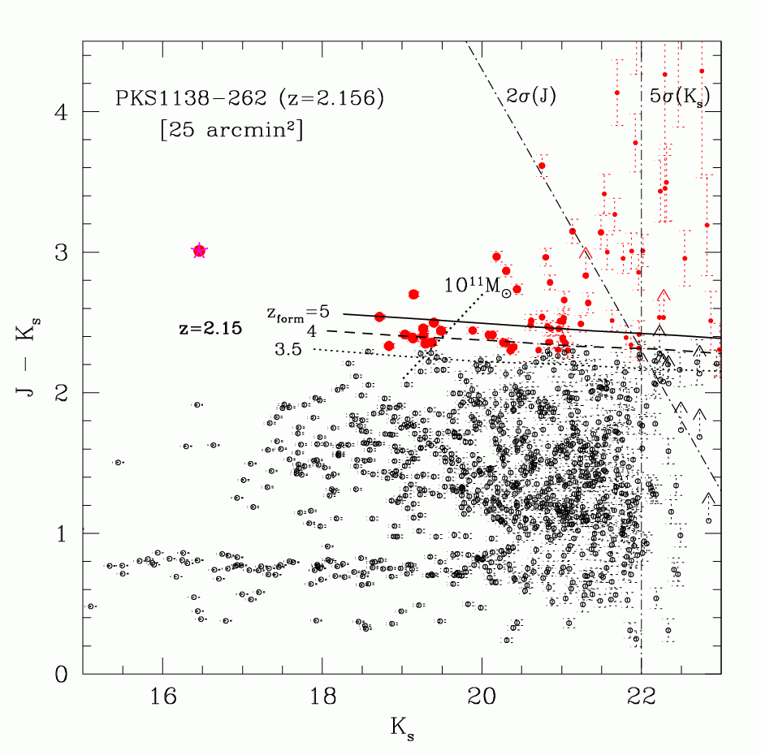
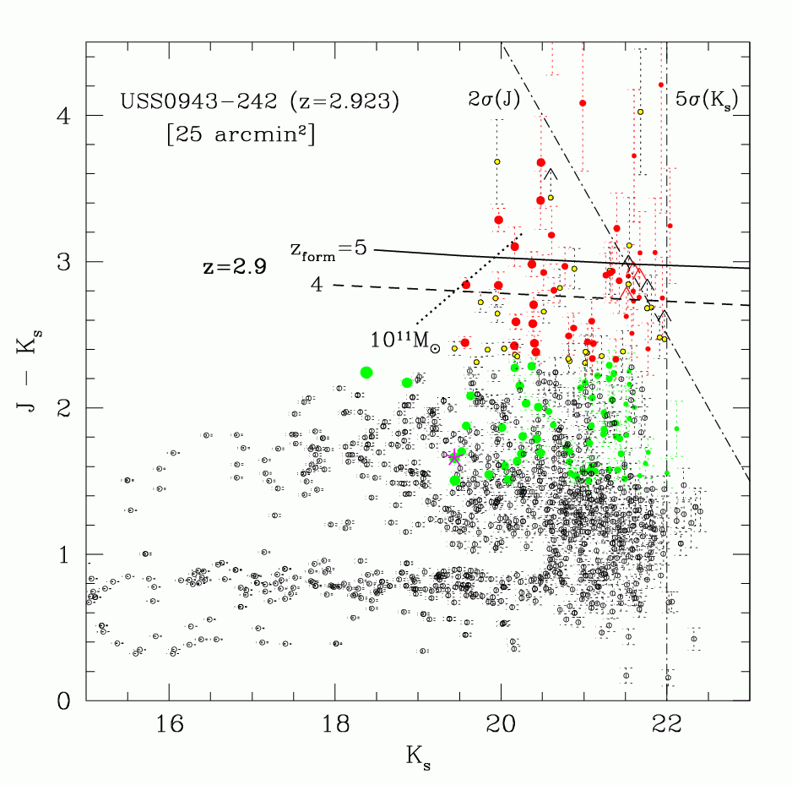
Emergence of the red-sequence at z~2 in proto-clusters?
z~2 (PKS1138)
z~3 (USS0943)
● DRG(J-K>2.3)
● r-JHK ● b-JHK
RG
Kodama et al. (2007)
The red sequence seems to be emerging between z=3 and 2 ( 2 < Tuniv[Gyr] < 3).

Slide 26
Summary
Starbursts/truncation of galaxies in groups/ outskirts of clusters at z<1
→ External effects (“Nurture”)
(galaxy-galaxy interaction?)
Formation of massive galaxies in cluster cores at z>1.5-2
→ Intrinsic effects (“Nature”)
(galaxy formation bias?)
“Inside-out propagation/truncation of star formation in clusters?”

